Slide 1
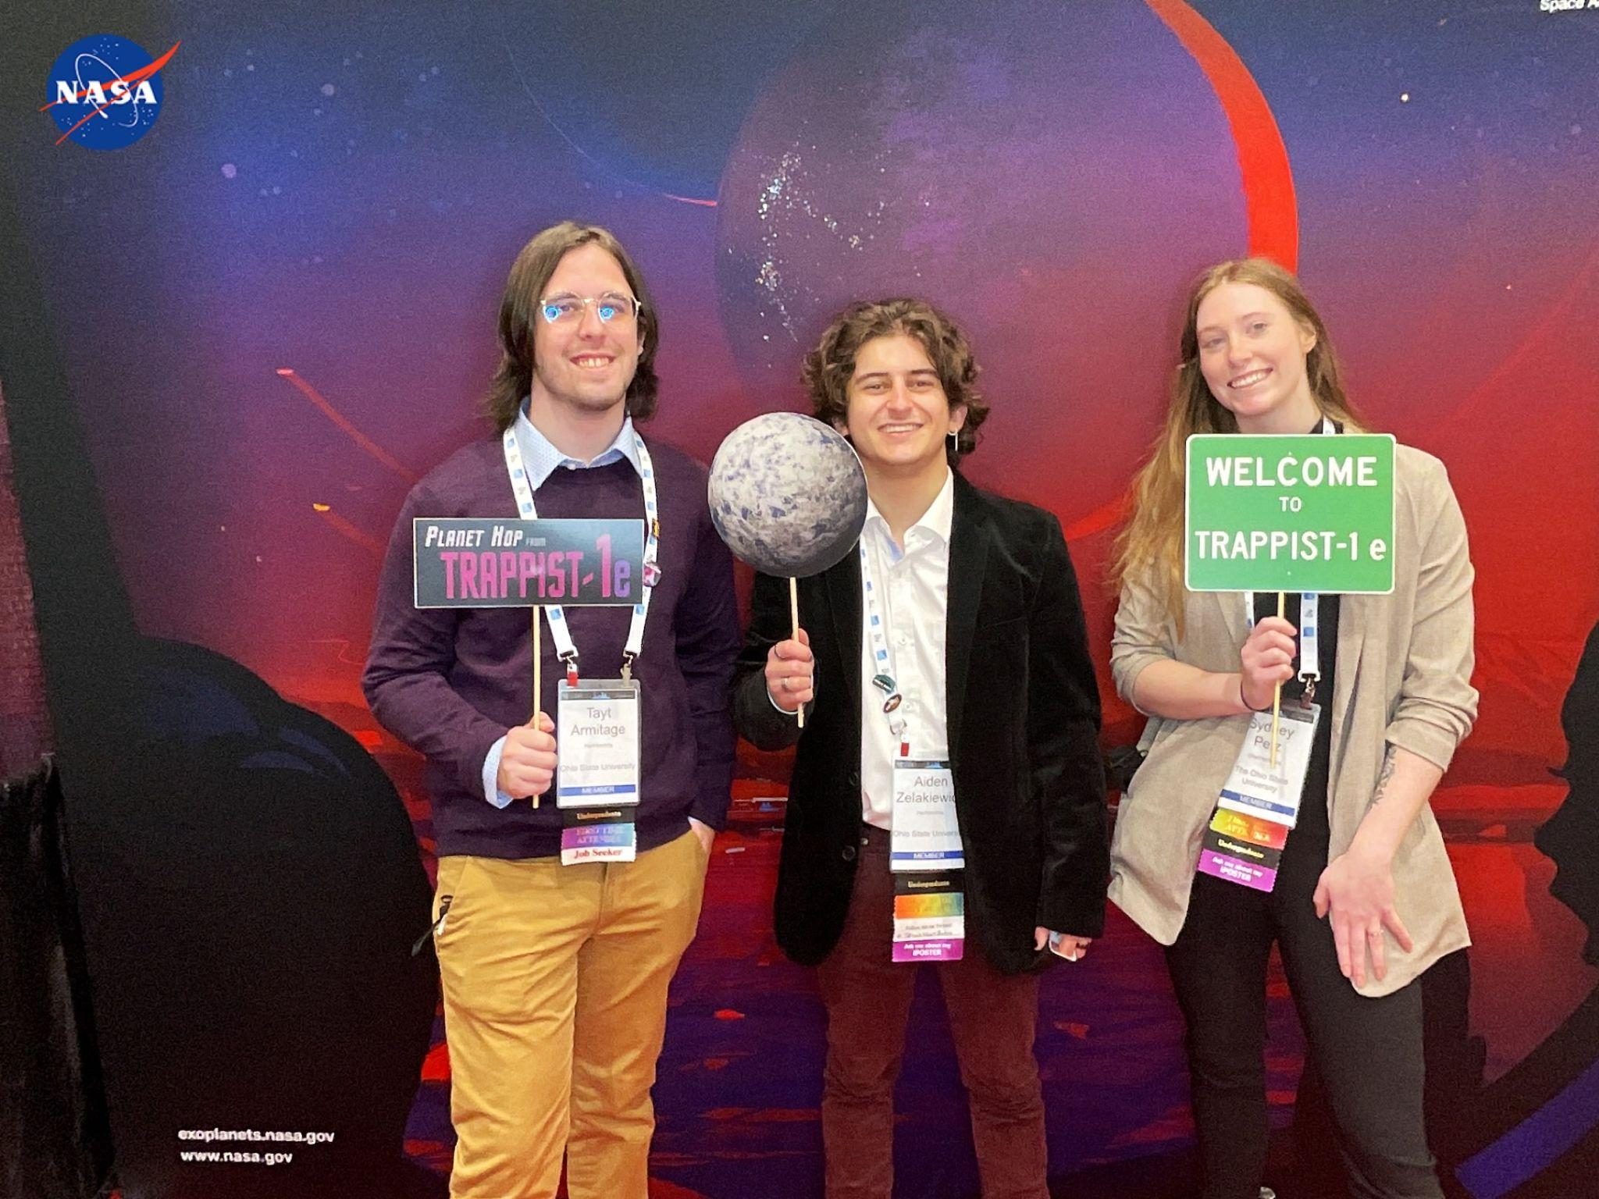

Finding the composition of Trappist-1e
Sydney Petz, Aiden Zelakiewicz, Justin Anderson

Slide 2


Motivations
Notes:
Motivation 1, is like a lot of what we have done in this class we are attempting to to find Earth 2.0 and habitable planets in general for our understanding of how life forms.
Motivation 2 is using information like mass and stellar composition to characterize and understand planetary composition
As we all know by now, understanding planetary composition is vital to our detection of biosignatures and life in general.

Slide 3
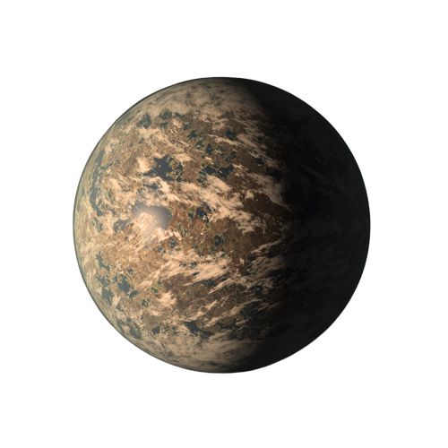
Trappist-1e
M = 0.692 M⨁
Orbital Distance = 0.029 AU
Agol et al. 2021
Notes:
As shown by our wonderful title slide, we have selected the planet Trappist-1e. There have been many studies of Trappist-1e since the famous paper by Gillon in 2017. But We decided to use the data obtained from Agol 2021 because of recency and the original paper had large errors. Obviously, the data from Agol 2021 has the mass at .692 earth masses and an orbital distance of 0.029 astronomical units.

Slide 4
Composition
Si/Mg = 0.71
Fe/Mg = 1.13
Griffith et al. 2021
Notes:
We needed certain molar abundances so we could input these into exoplex, and these values were derived using Griffith 2021 from the stellar metallicity obtained by Ducrot 2020.

Slide 5
Exoplex
Input composition values and planetary mass
Returns planetary radius
R = 0.92 R⨁
Notes:
Using the previous slides composition values and Trappist-1e’s mass, we entered the information into exoplex and it returns a planetary radius. We aimed to match the radius to that of Agol 2021, and analyze the composition that yields such a radius.

Slide 6
ExoPlex - Core Composition
Fe: 94%
Si: 0%
O: 6%
S:0%
Notes:
While fixing the core mass fractions in the initialization of exoplex, we adjusted the amount of oxygen which is what got the radius to .92 earth radii. For a comparison, Earth actually has about 3.7% of oxygen in its own core according to Badro 2014.

Slide 7
ExoPlex Results
Mantle Composition
Core Mass Fraction
FeO: 0%
SiO₂: 58%
MgO: 34%
CaO: 3%
Al₂O₃ : 4%
26.69%
Core Radius Fraction
51.58%
Notes:
Here we have the resulting mantle composition produced from exoplex as well as the core mass fraction of Trappist-1e. Take note that the mantle is primarily comprised of silicon dioxide and magnesium oxide at 58% and 34% respectively. The core mass fraction is also not far off from earth’s.

Slide 8
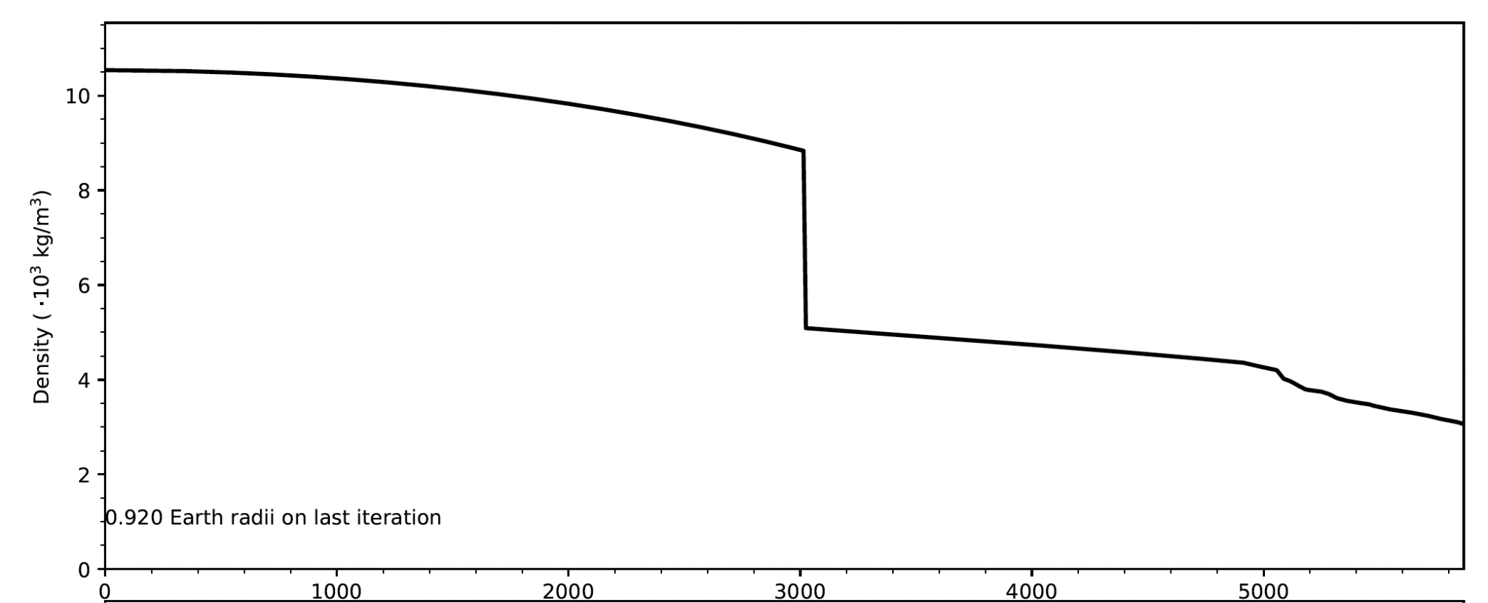
Radius (km)
Notes:
Up until 3000km is the dominantly iron core, where it switches to the mantle with the composition of the previous slide

Slide 9
How does this compare to Earth’s mantle?

Slide 10
Earth
Trappist-1e
FeO: 8%
SiO₂: 45%
MgO: 39%
CaO: 3%
Al₂O₃: 4%
FeO: 0%
SiO₂: 58%
MgO: 34%
CaO: 3%
Al₂O₃: 4%
Notes:
Here we can see they are fairly similar! As mentioned before take note of how high the silicon dioxide percentage is to earth’s, and given the higher percentages you might not be as surprised we had to adjust the oxygen to 6% rather than Earth’s, lower, 3.7% to obtain a radii consistent with Agol 2021.

